Slide 1
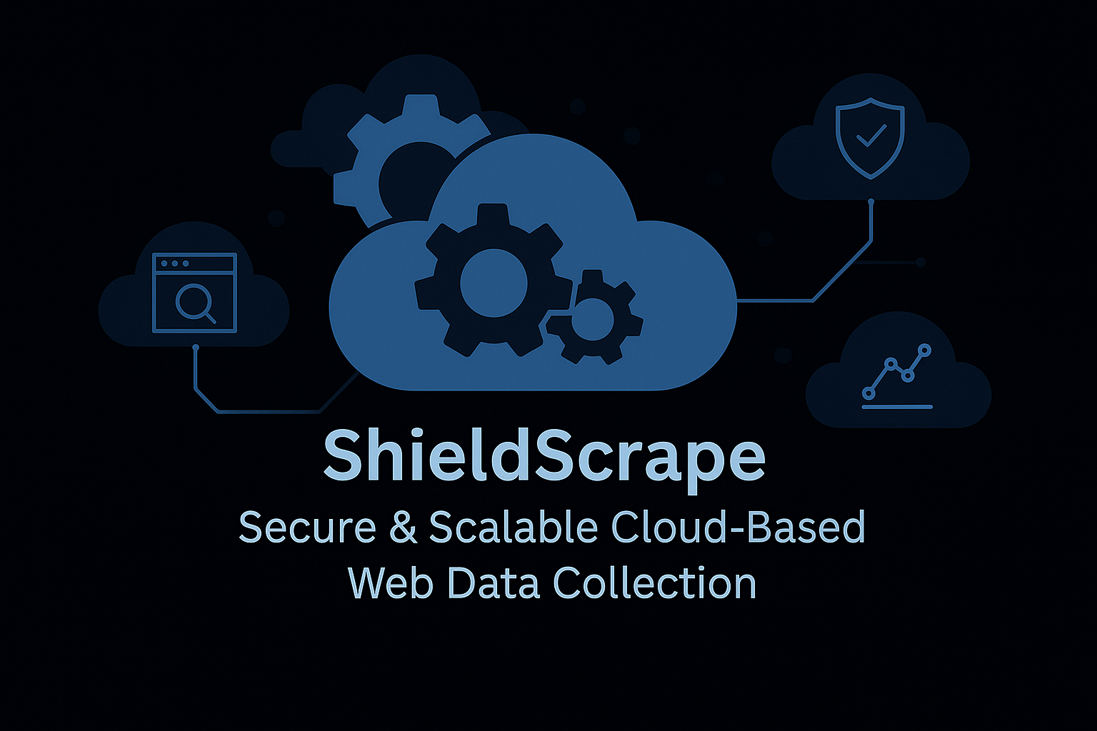

Slide 2

Collect live ESPN sports data.
Automate cleaning, storage, querying, and visualization.
Achieve serverless end-to-end cloud architecture.
Project Goal

Slide 3
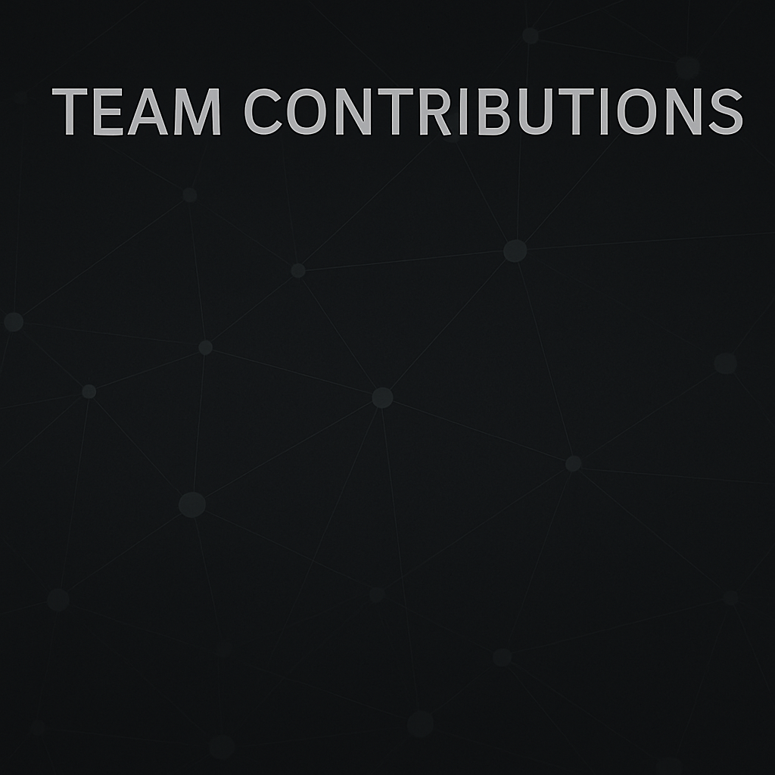
Team Contributions
Shivali Mate - Developed the job scrapers and implemented containerization using Docker for scalable deployments.
Varun Sonawane - Designed and built the ETL pipeline integrating AWS services such as Glue, S3, DynamoDB, and Athena.
Aryan Dhuru - Implemented end-to-end automation, including job scheduling, orchestration with EventBridge, and scripting of cloud workflows.
Suhana Ambol – Created impactful data visualizations using Amazon QuickSight and led project documentation efforts.

Slide 4
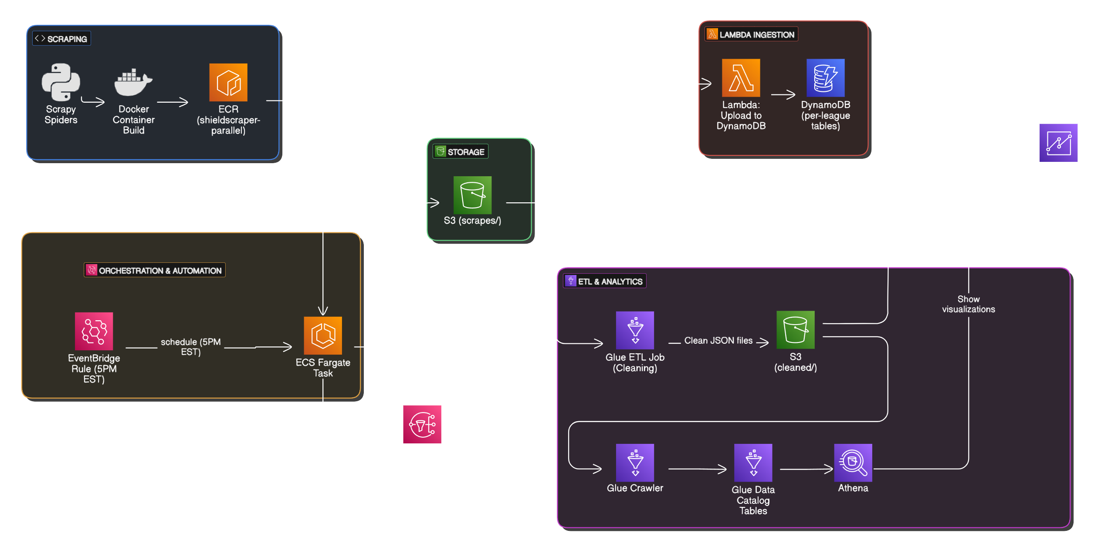
ShieldScraper Cloud Architecture: End-to-End Data Flow

Slide 5

Phase 1: Scraping and Containerization
Developed multiple Scrapy spiders for different leagues.
Fields: Team Name, matches played, wins, draws, losses, goals, and points.
Created a Fargate handler to run spiders in parallel.
Dockerized the entire scraping setup.
Pushed Docker image to AWS ECR (shieldscraper-parallel) repo.

Slide 6
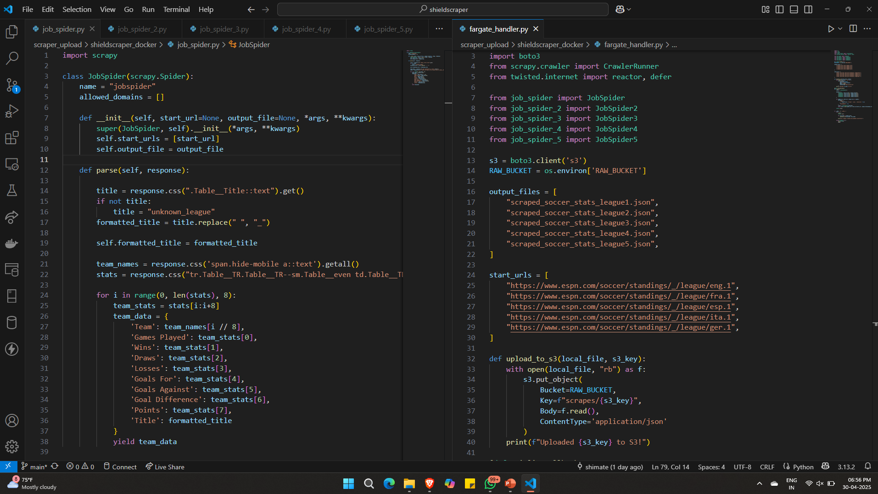
Phase 1: Scraping and Containerization

Slide 7
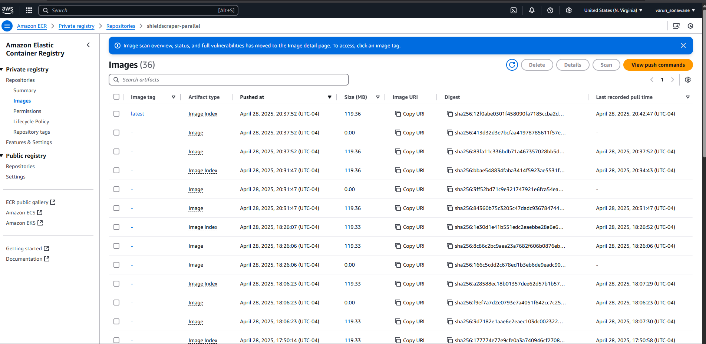
Phase 1: Scraping and Containerization

Slide 8
Phase 2: Scheduled Trigger using EventBridge
Created AWS EventBridge rule with daily trigger at 05:00 pm EST.
Event triggers ECS task in shieldscraper-cluster1.
Task definition: shieldscraper-parallel-task

Slide 9
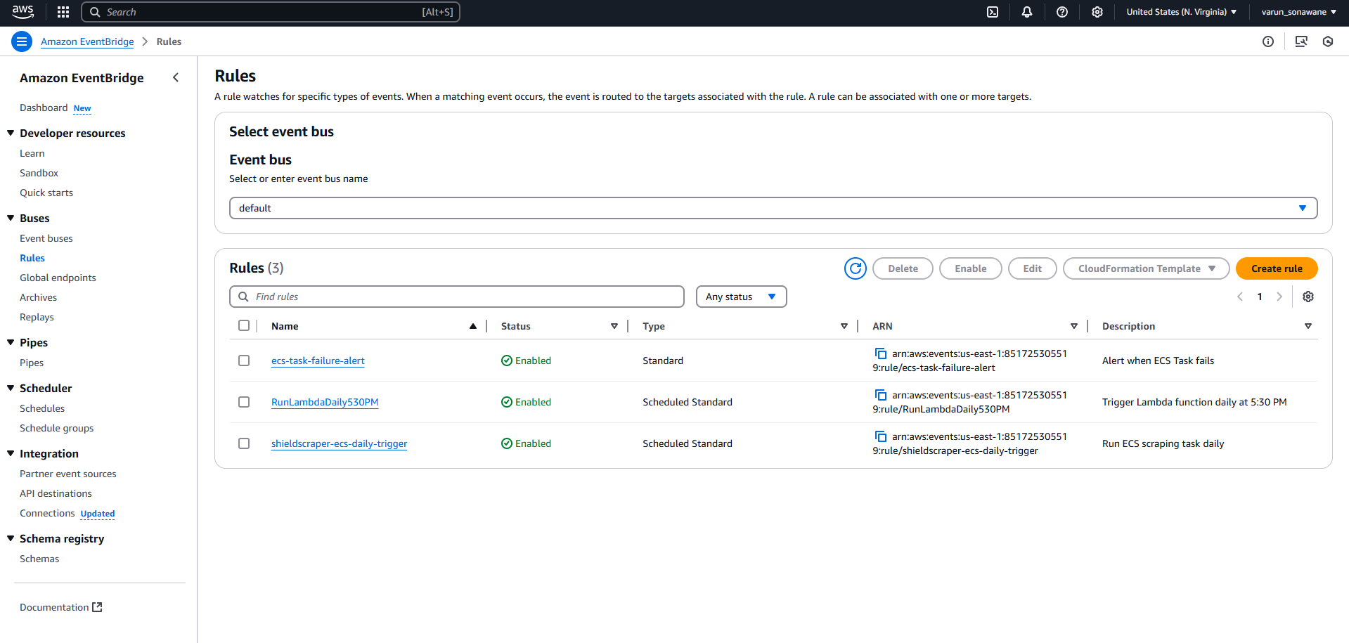
Phase 2: Scheduled Trigger using EventBridge

Slide 10
Phase 3: Data Collection (Scraping)
Fargate ECS Task launches Scrapy spiders.
Fresh soccer standings are scraped.
Output stored to Amazon S3 Bucket.

Slide 11
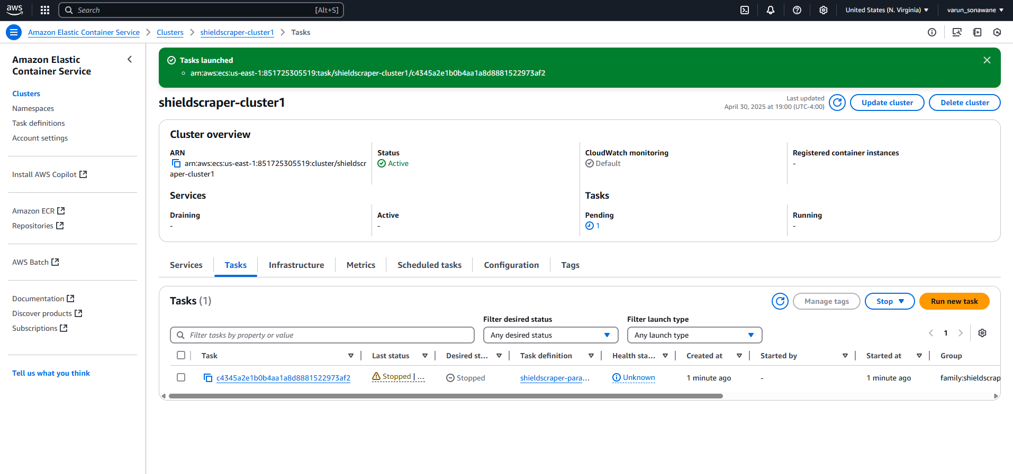
Phase 3: Data Collection (Scraping)

Slide 12
Phase 4: ETL with AWS Glue
AWS Glue job (shieldscraper-cleaning-job) starts.
Reads raw files from S3.
Cleans and formats the data.
Stores the clean JSON into: s3://iu-sheild-scraper-bucket/cleaned/

Slide 13
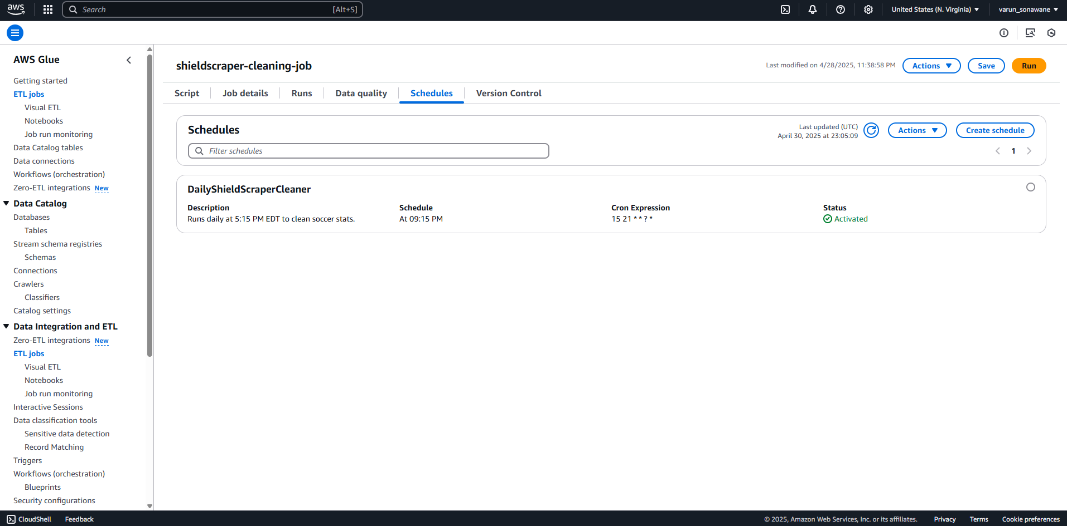
Phase 4: ETL with AWS Glue

Slide 14
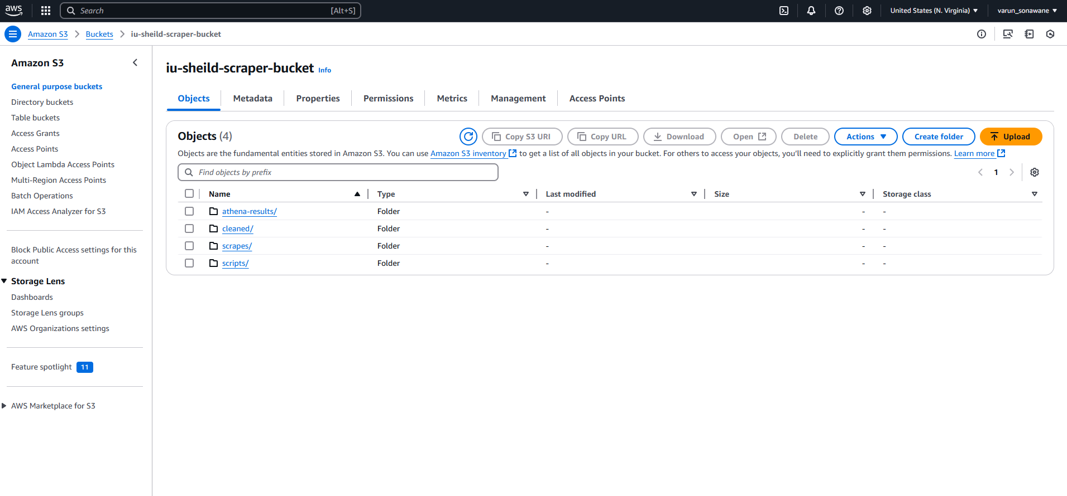
Phase 4: ETL with AWS Glue

Slide 15
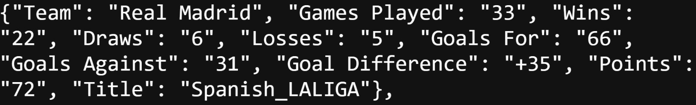
Raw Data VS Cleaned Data
Raw data

Slide 16
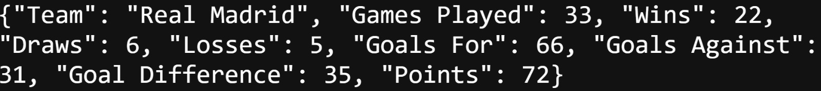
Raw Data VS Cleaned Data
Cleaned data

Slide 17
Phase 5: DynamoDB update via Lambda
AWS Lambda function triggers after ETL completes.
Pulls cleaned data from /cleaned/.
Uploads records into separate DynamoDB tables (per league).

Slide 18
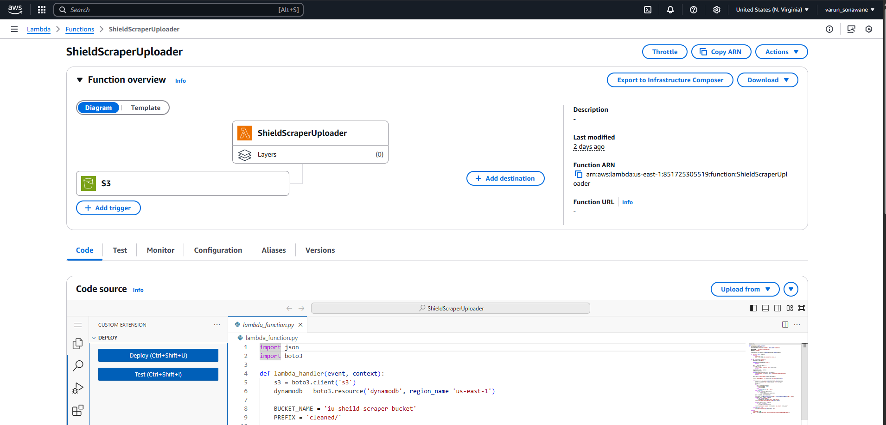
Phase 5: DynamoDB update via Lambda

Slide 19
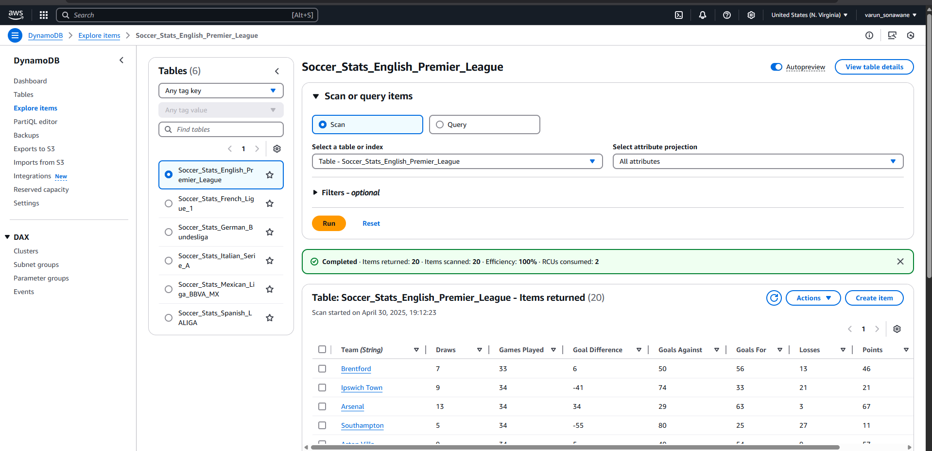
Phase 5: DynamoDB update via Lambda

Slide 20
Phase 6: Glue Crawler Refresh
Lambda function triggers AWS Glue Crawler.
Updates Glue Catalog with latest S3 data structure.

Slide 21
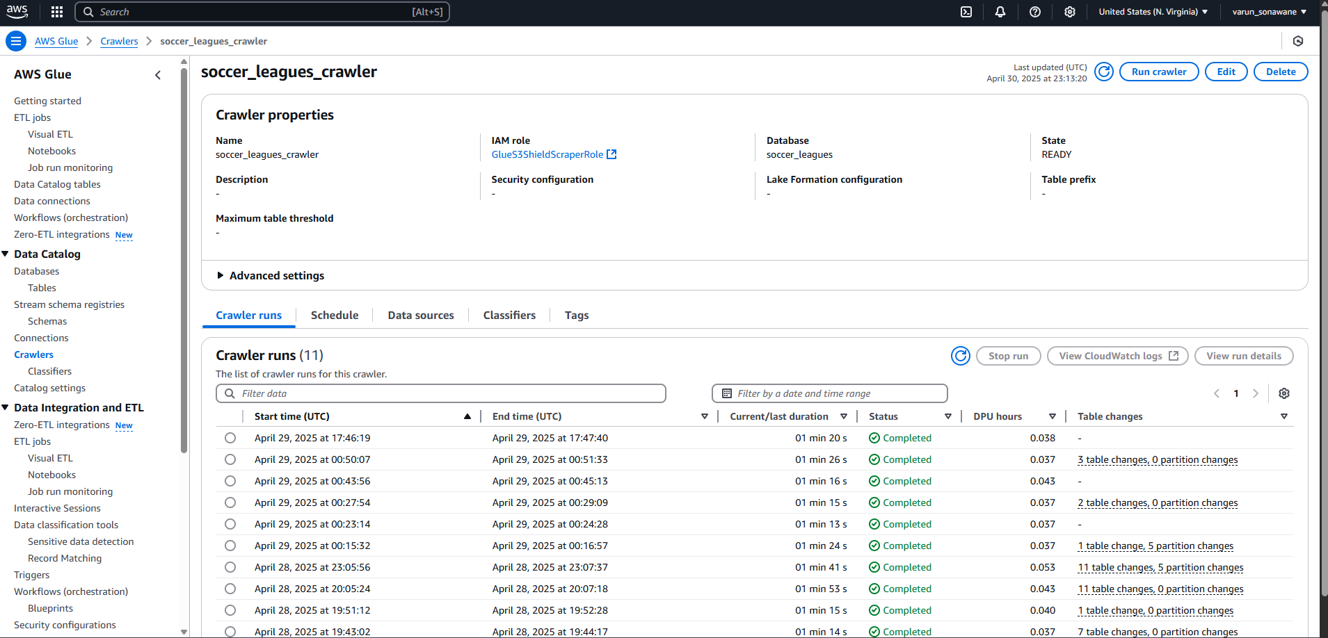
Phase 6: Glue Crawler Refresh

Slide 22
Phase 7: Query via Amazon Athena and Visualization with QuickSight
Glue Tables auto-created from Crawler metadata.
Data instantly queryable using Amazon Athena SQL.
Build QuickSight dashboards linked to Athena tables.
Dashboard automatically refreshes with latest soccer data.

Slide 23
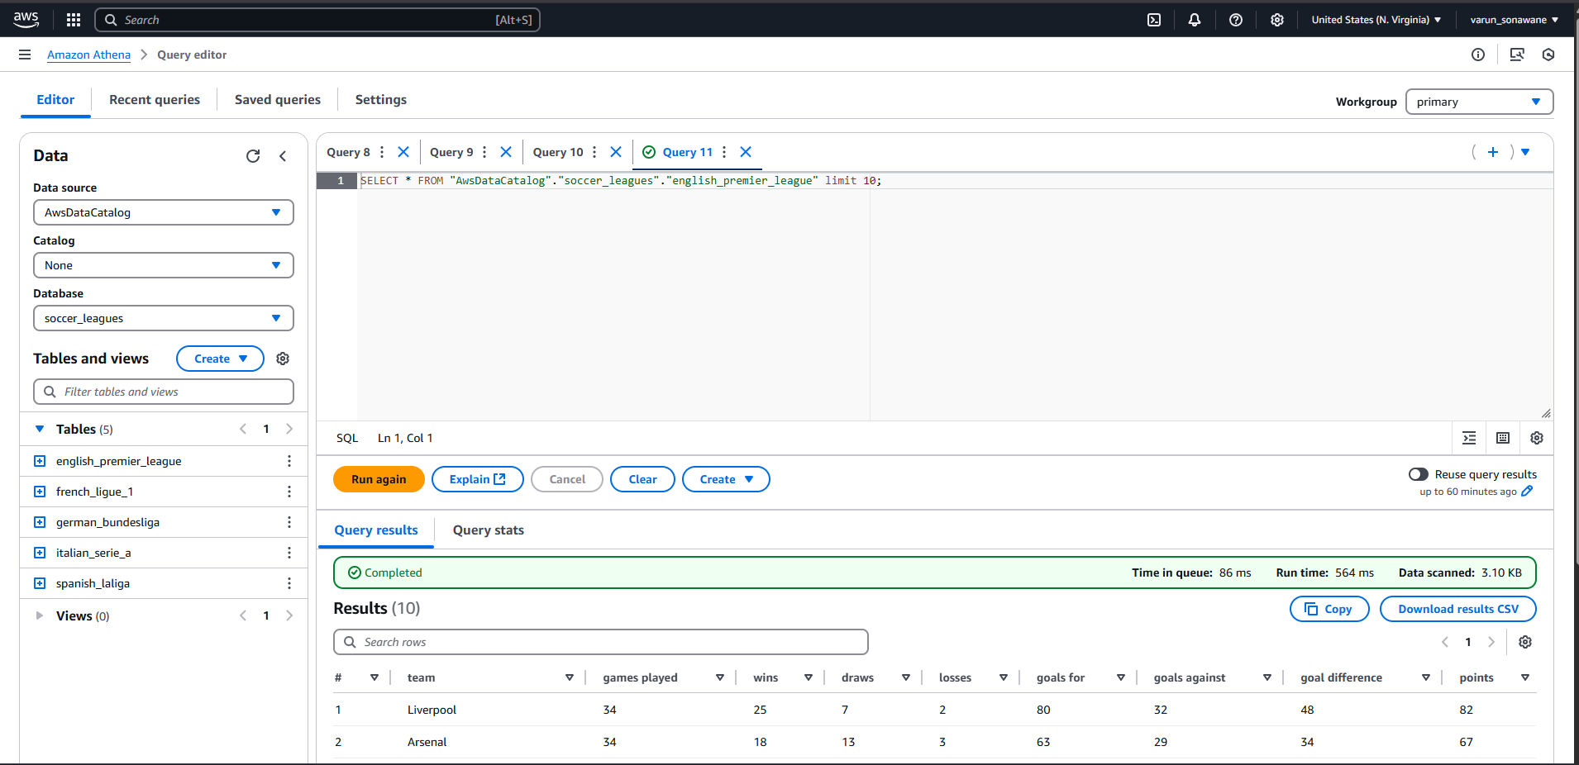
Phase 7: Query via Amazon Athena and Visualization with QuickSight

Slide 24
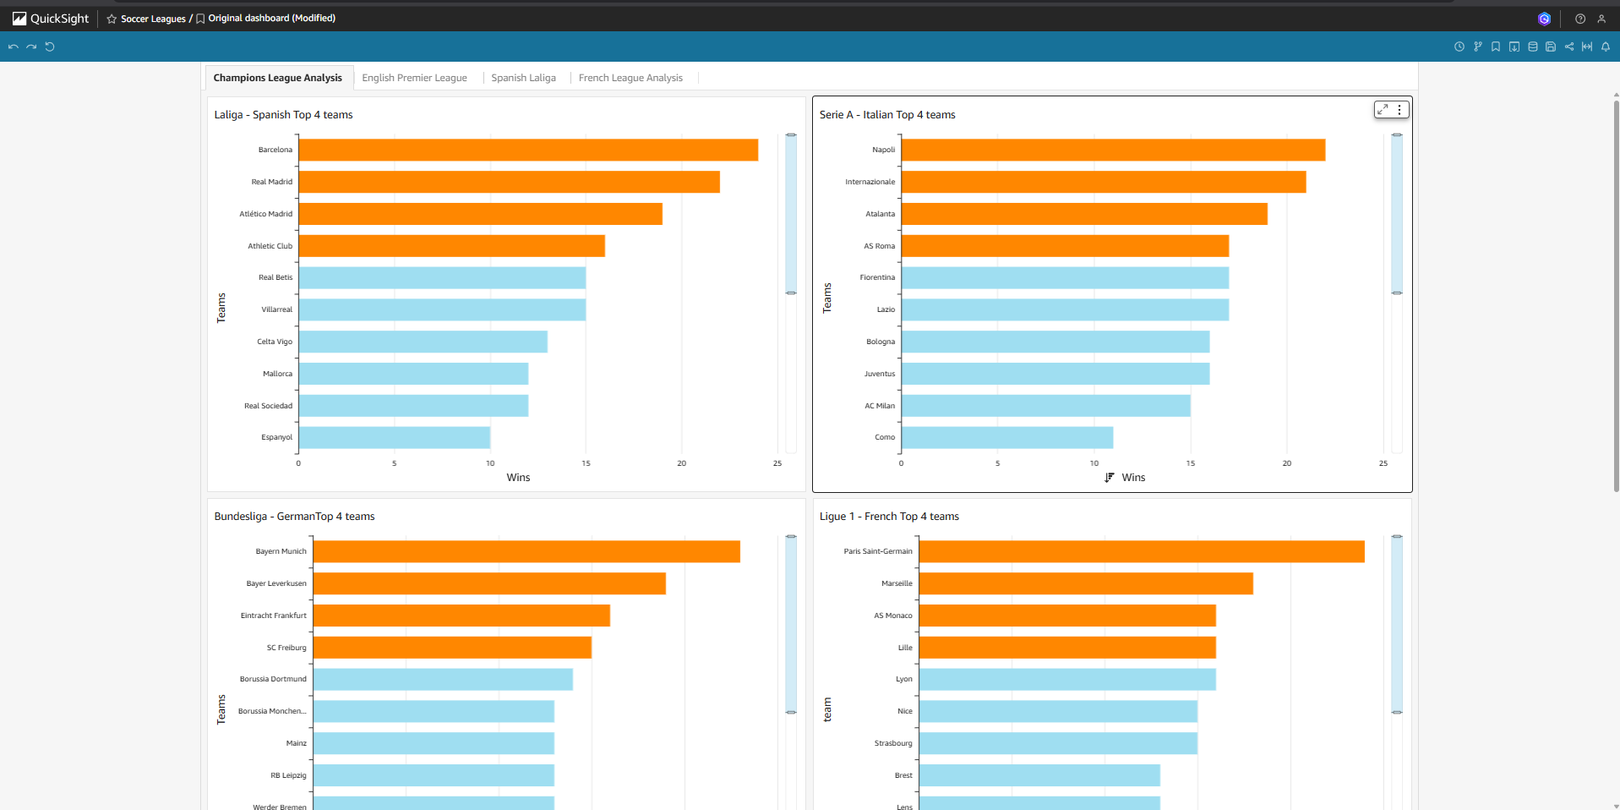
Phase 7: Query via Amazon Athena and Visualization with QuickSight

Slide 25
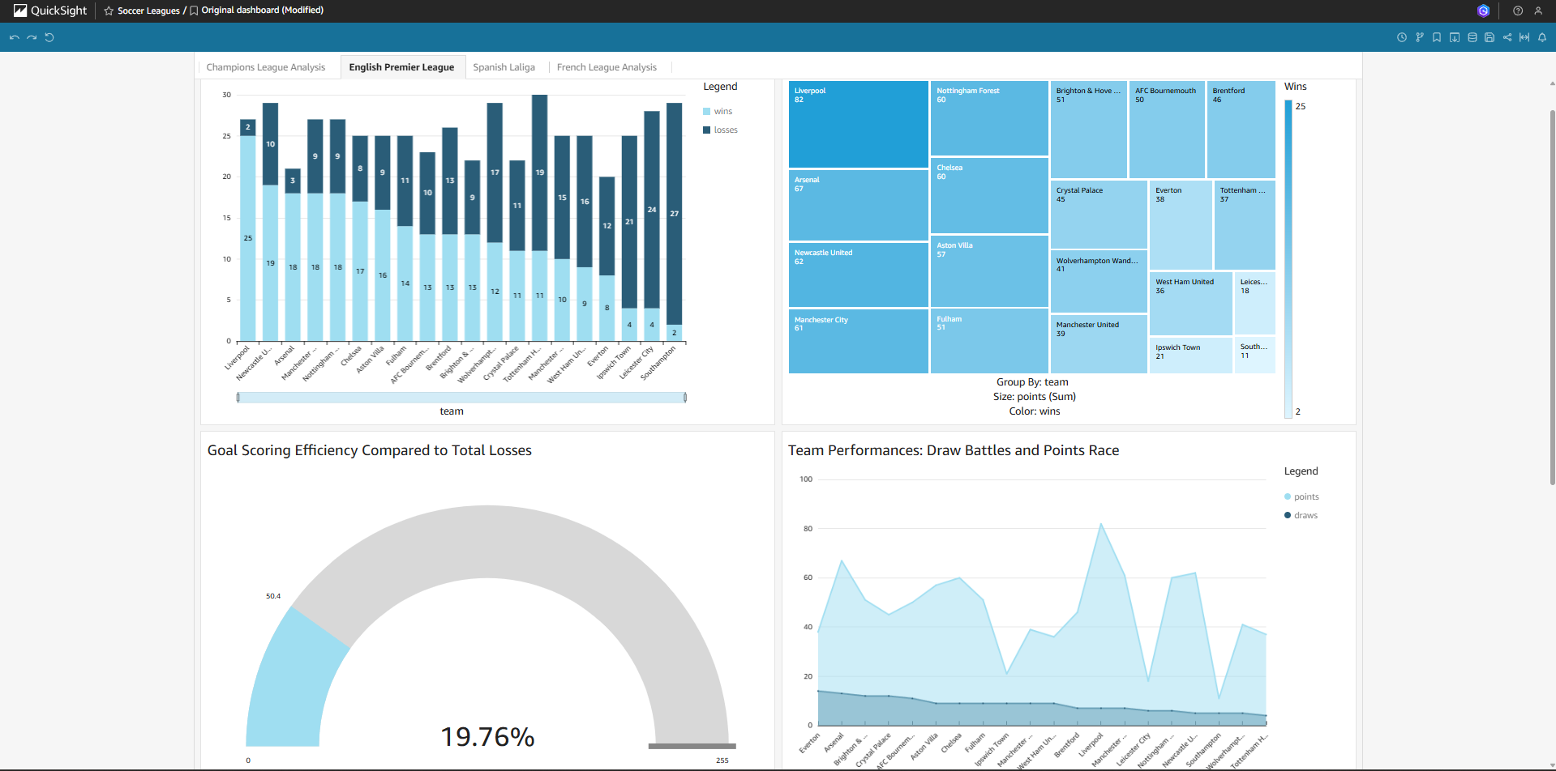
Phase 7: Query via Amazon Athena and Visualization with QuickSight

Slide 26
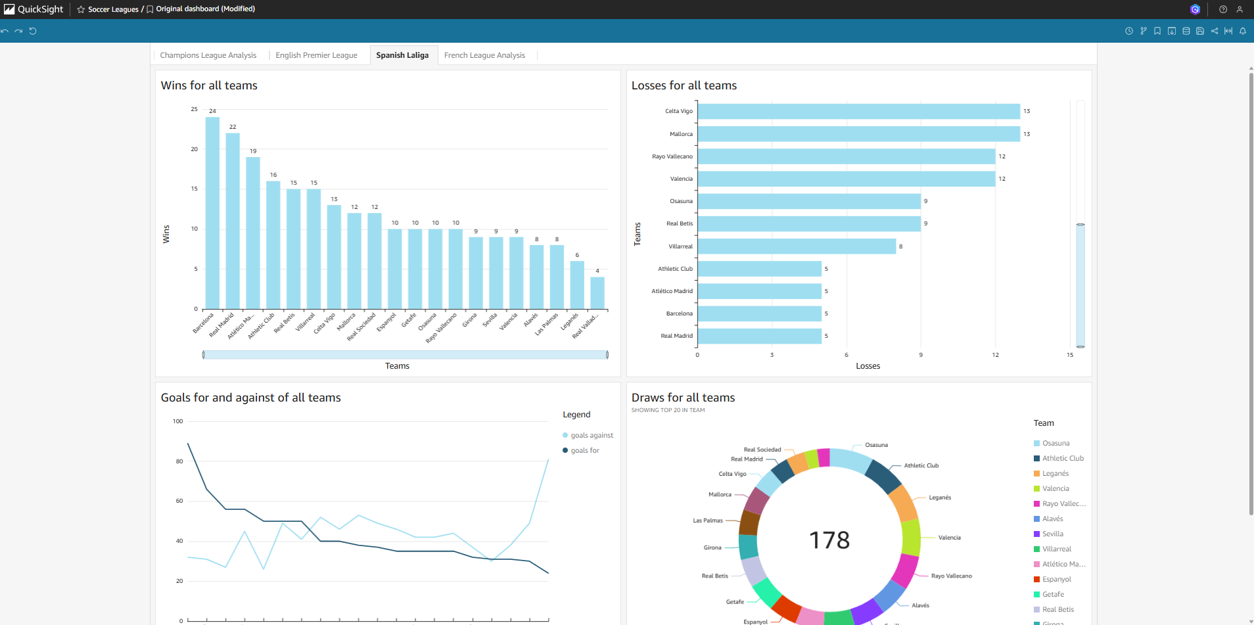
Phase 7: Query via Amazon Athena and Visualization with QuickSight

Slide 27
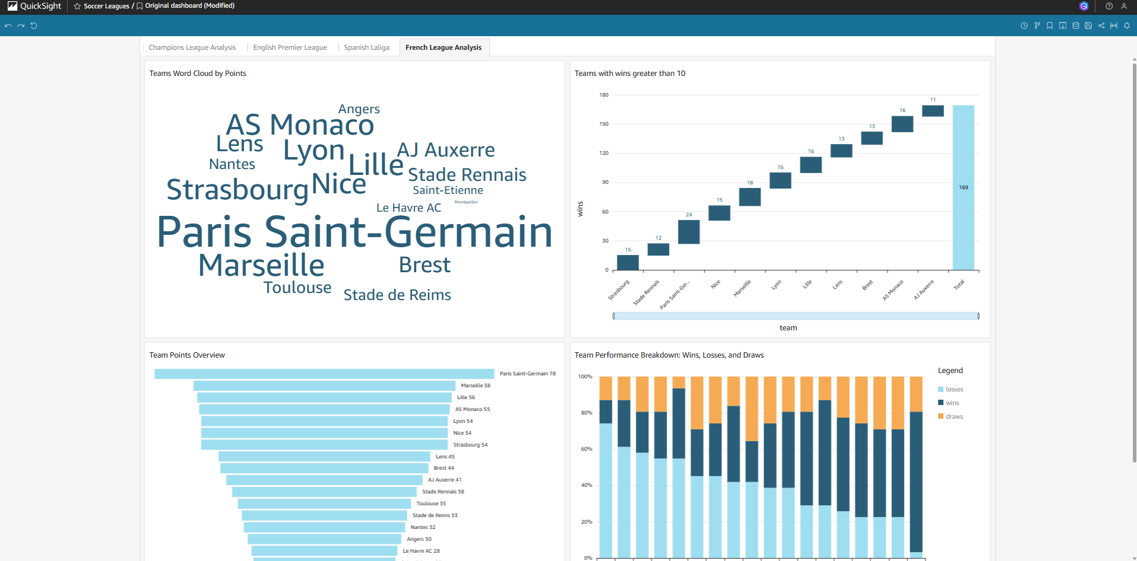
Phase 7: Query via Amazon Athena and Visualization with QuickSight

Slide 28
Execution Timeline
Timeline of a ShieldScraper Run
Time (EST) | Actions
05:00 PM | EventBridge triggers ECS Fargate
05:10 PM | Scraping completes, saved to S3
05:15 PM | Glue ETL cleans and stores to /cleaned/
05:25 PM | Lambda uploads to DynamoDB
05:30 PM | Glue Crawler refreshes catalog
06:00 PM | Dashboards show updated data

Slide 29
Conclusion
ShieldScraper achieves fully automated, scalable sports data collection and visualization using serverless cloud technologies, delivering fresh insights daily with minimal operational effort.
The project demonstrates strong system design, cloud automation, and scalable data engineering practices.

Slide 30


